Slide 1
PowerShell 💖’s Intune: Measure twice, Deploy Once
Ben Reader & Steven Hosking

Slide 2

Many thanks to our sponsors:

Slide 3

Speaker name
Your bio
You can download your shield here:
Speakers shields
If any problem with you shield, please contact us at contact@psconf.eu

Slide 4
Slide title
Sample text for your PSConf.EU 2022 presentation
We usually prefer demos, use slides with moderation
Think about those at the back of the room, some text might be too small.
Think about accessibility, try to improve the contrast, colours and size of your presentation.

Slide 5
Instructions
Use this template if you want, it’s preferred but not mandatory.
Please make sure our sponsors are mentioned on your first slide after the title.
Do not amend the ratio or the colours of the sponsors’ logo and background.
Update your twitter handle through the master page (see next slides).

Slide 6
Instruction (Continued)
The session is 30 min.
Then 15min Q&A.
At the end of your 45 min, please leave the room to the next speaker.
You’re welcome to continue the discussion in the Foyer area.

Slide 7
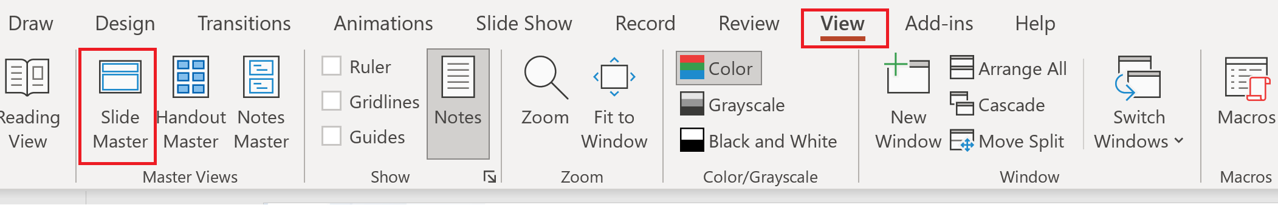
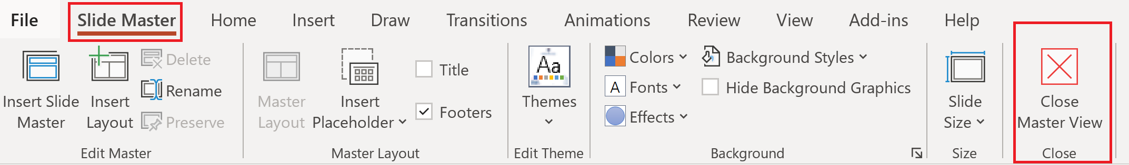
Update the twitter handle on the master slide
To open the slide master:
To close the Master view:
If you need any help, do not hesitate to email us at psconfeu@synedgy.com

Slide 8
Demos
We love Demos!

Slide 9
Q&A
15 minutes

